Slide 1
Predictive Analysis For Food Consumption
Team #7
Ogedengbe Lolade
KeshavaMurthy Shirish
Patil Shubhangi

Slide 2
Agenda
BackGround
DataSet
Data Cleaning
Models for Prediction
Best Model
Results
Visualization of Predictions
Conclusion

Slide 3
Background
Future food consumption, production and population are predicted from past dataset
Interesting problem as it gives food population and food consumption prediction for future years
The topic will help us realize to the statistics and hence change the ways food is managed in recent years

Slide 4
DataSet – DataSet Part 1
Released by International Food Security consists of food availability for 76 low and middle income countries over a 10-year period
The data consists from 1990 to 2014
Grain and roots and tuber data are obtained from the FAOSTAT Production and Food Supply databases

Slide 5
DataSet – Part 2
These databases contain country data as reported by national governments and provide comprehensive global coverage of supply and use of both grains and roots and tubers
International food aid delivery data are from the World Food Programme (WFP), the organization that coordinates and delivers most of the international food aid
Economic variables such as GDP and total imports and exports are obtained from the World Bank’s online database

Slide 6
Data Cleaning
Checking for missing values : No missing values
Check for redundant/ irrelevant attributes: No such values
Clusteing: Combination of attributes into one cluster such that objects in them are more similar to each other

Slide 7
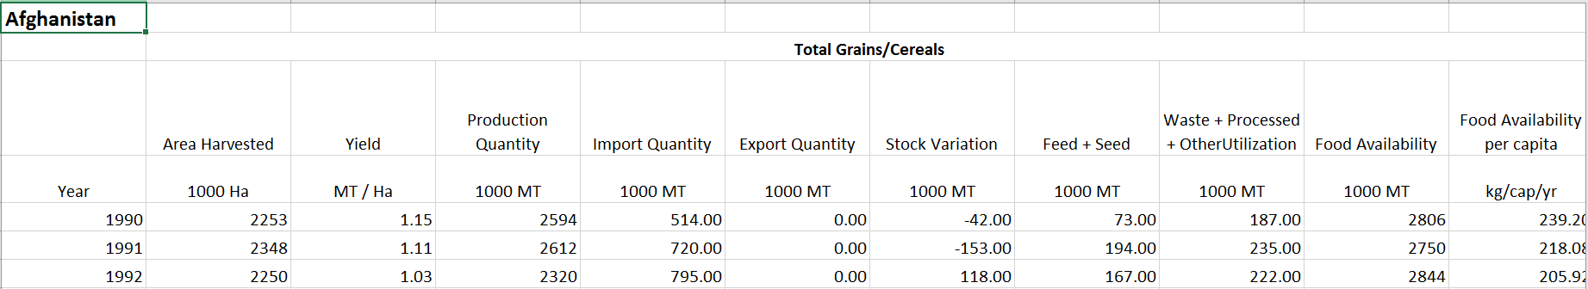
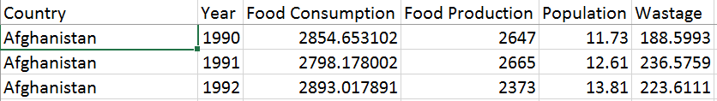
Clustering Example

Slide 8
Attributes
Attributes | Description
Year | Time period
Country | Location
Food production | Total production quantity for Grains/Cereals and Root crops (R&T)
Food consumption | Total food availability for Grains/cereals and Root Crops (R&T)
Wastage and Processing | Total Waste + Processed + other utilization for Grains/Cereals and Root crops (R&T)
Population | Total population of a country –Both Sexes (in millions)

Slide 9
Models for Prediction
SVM (Support Vector Machines) – They are supervised learning models.
Given a set of training examples, each marked as belonging to one or the other of two categories, an SVM training algorithm builds a model that assigns new examples to one category or the other.
The results for dataset were not good so considered to go with different models.

Slide 10
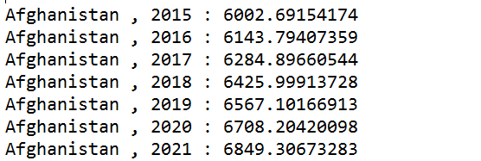
Linear Regression - attempts to model the relationship between two variables by fitting a linear equation to observed data.
One variable is considered to be an explanatory variable, and the other is considered to be a dependent variable.
Example for single country

Slide 11
Future Model
Decision Trees - Decision trees tend to be the method of choice for predictive modeling because they are relatively easy to understand and are also very effective.
The basic goal of a decision tree is to split a population of data into smaller segments.
There are two stages to prediction:
The first stage is training the model—this is where the tree is built, tested, and optimized by using an existing collection of data.
In the second stage, you actually use the model to predict an unknown outcome.

Slide 12
Results –
Year | Food Consumption | Food Production | Wastage and Processing | World Population
2015 | 611444.6378 | 408600.82 | 120741.1427 | 3496.2616
2016 | 616382.799 | 413348.6269 | 122437.7786 | 3522.882815
2017 | 621320.9601 | 418096.4338 | 124134.4146 | 3549.504031
2018 | 626259.1213 | 422844.2408 | 125831.0506 | 3576.125246
2019 | 631197.2824 | 427592.0477 | 127527.6865 | 3602.746462
2020 | 636135.4436 | 432339.8546 | 129224.3225 | 3629.367677
2021 | 641073.6048 | 437087.6615 | 130920.9585 | 3655.988892
2022 | 646011.7659 | 441835.4685 | 132617.5944 | 3682.610108
2023 | 650949.9271 | 446583.2754 | 134314.2304 | 3709.231323
2024 | 655888.0882 | 451331.0823 | 136010.8664 | 3735.852538
2025 | 660826.2494 | 456078.8892 | 137707.5024 | 3762.473754
2026 | 665764.4106 | 460826.6962 | 139404.1383 | 3789.094969
2027 | 670702.5717 | 465574.5031 | 141100.7743 | 3815.716185
2028 | 675640.7329 | 470322.31 | 142797.4103 | 3842.3374
2029 | 680578.8941 | 475070.1169 | 144494.0462 | 3868.958615
2030 | 685517.0552 | 479817.9238 | 146190.6822 | 3895.579831
2031 | 690455.2164 | 484565.7308 | 147887.3182 | 3922.201046
2032 | 695393.3775 | 489313.5377 | 149583.9541 | 3948.822262
2033 | 700331.5387 | 494061.3446 | 151280.5901 | 3975.443477
2034 | 705269.6999 | 498809.1515 | 152977.2261 | 4002.064692
2035 | 710207.861 | 503556.9585 | 154673.8621 | 4028.685908

Slide 13
Graph showing the world future data

Slide 14
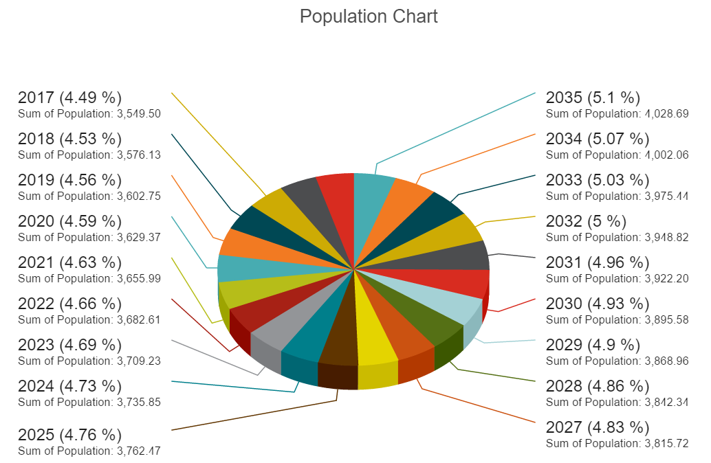
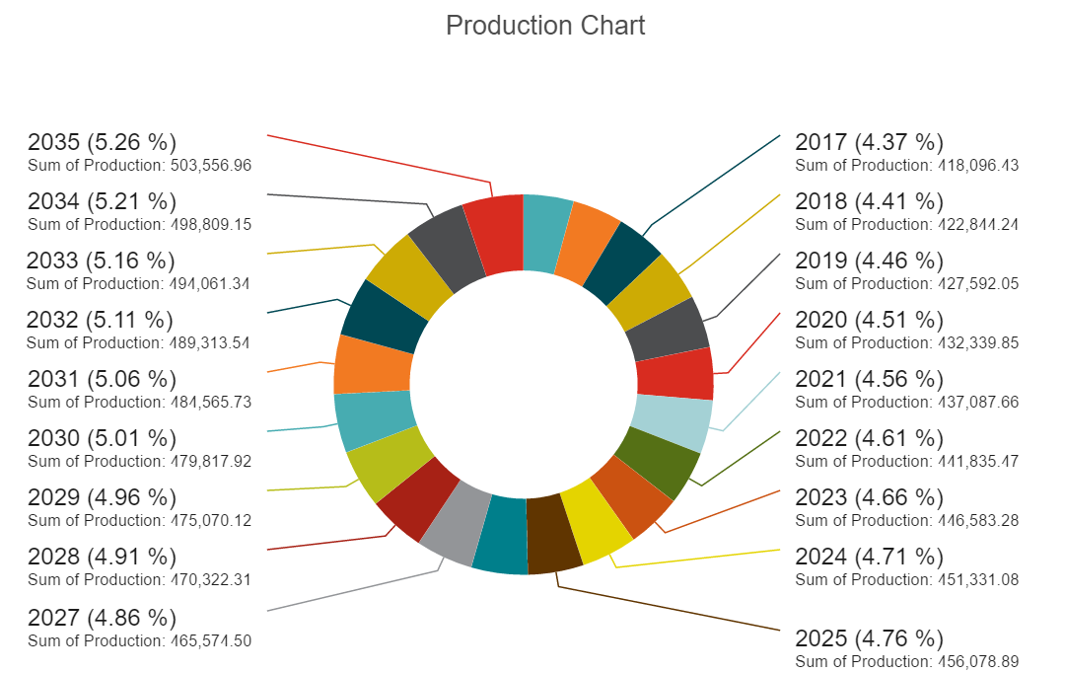
Results - Visualization Of Data with DataHero

Slide 15
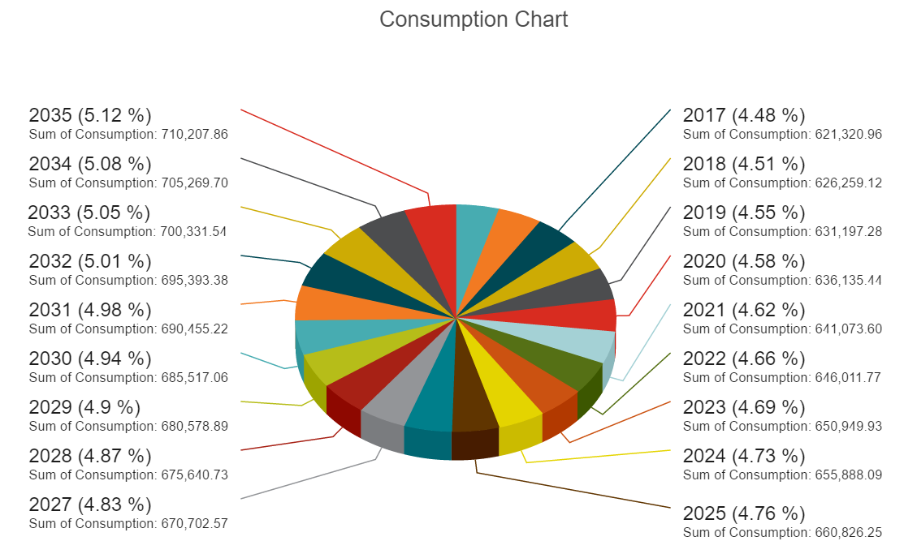
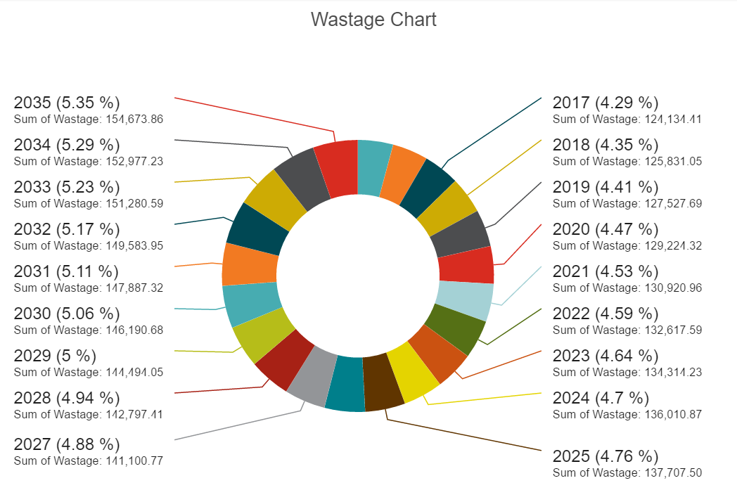

Slide 16
Future Visualizations
MatPotlib – A python 2D plotting library which produces publication quality figures in a variety of hardcopy formats and interactive environments across platforms.
Tableau Public – This gives an opportunity to create dashboards and stories, so will try to implement this as another option for the visualization.
Excel E2D3 - Create dynamic and interactive graphs on Excel
https://bost.ocks.org/mike/nations/

Slide 17
Conclusion
The predicted data can be used to improve the quantity and quality of agricultural statistics.
These organizations share the goal of developing a framework for improving national and international statistical systems to produce basic data and information to guide public and private decision makers.

Slide 18
THANK YOU
Questions ?

